Slide 1

Automated User Interface Testing
Jonathan Jarrett
Early Careers Developer

Slide 2
Overview
Short presentation covering:
What is automated UI testing?
Frameworks on offer
Cypress Testing & set up
Questions
Break Activity: Superpowers, keyboard shortcuts and more… (5 minutes)
Task One: Simple Cypress Tests
Task Two: Stubbing and mocking in Cypress

Slide 3


The Test Pyramid
Exploratory Testing
slow
UI Tests
Integration Tests
It’s actually a triangle, not a pyramid
fast
Unit Tests

Slide 4
What is automated UI testing?
Testing an application from the user’s point of view

Slide 5
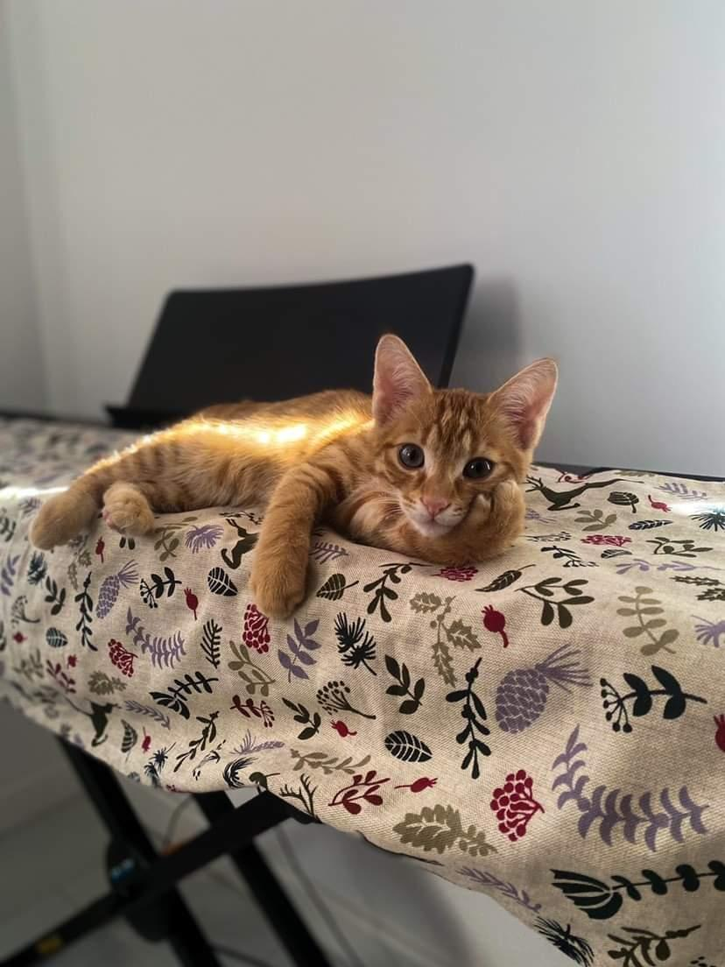
What is automated UI testing?
Mimics user behavior and interactions
Captures these in the form of a test
Make assertions along the way
Visit reddit.com
Click on search bar
type “r/cute”
Click search button

Slide 6
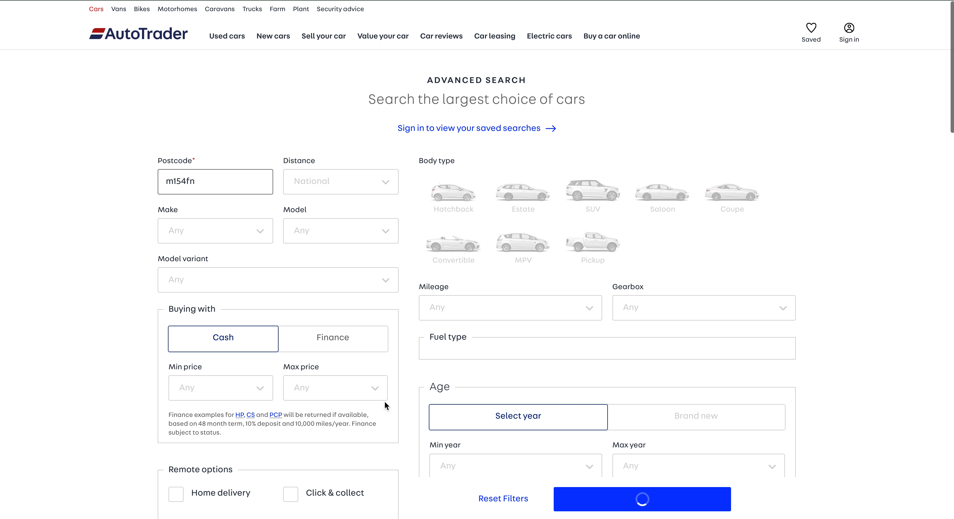
What is automated UI testing?

Slide 7

Why do we automate UI testing?
Manual regression testing is:
Slow
Boring
Ineffective
Restricts tester’s time

Slide 8
Why do we automate UI testing?
Automated regression testing is:
Fast (compared to a human)
Computers don’t get bored
Effective
Gives tester’s time to do exploratory testing

Slide 9

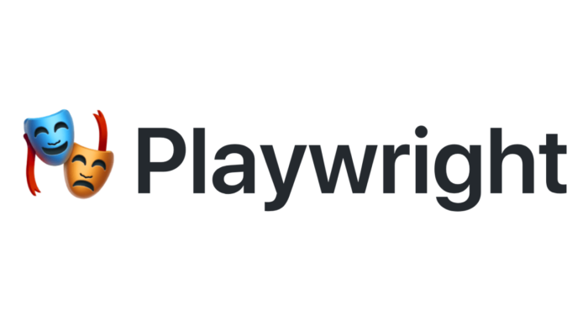
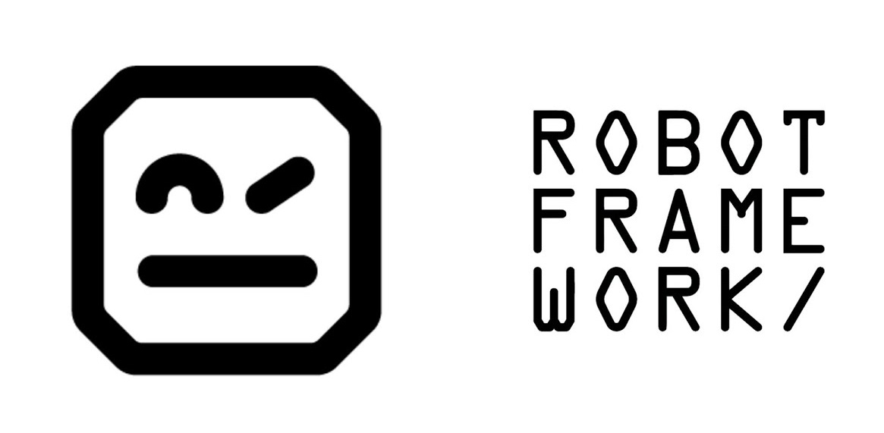
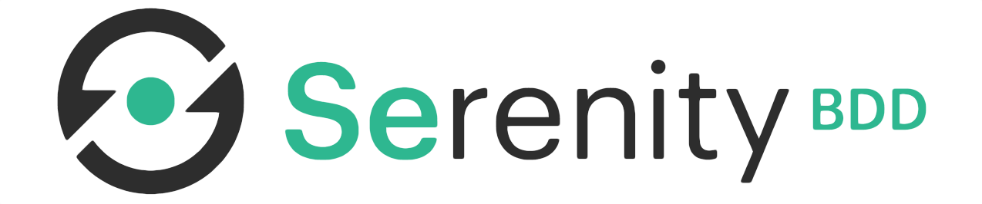
Frameworks On Offer

Slide 10

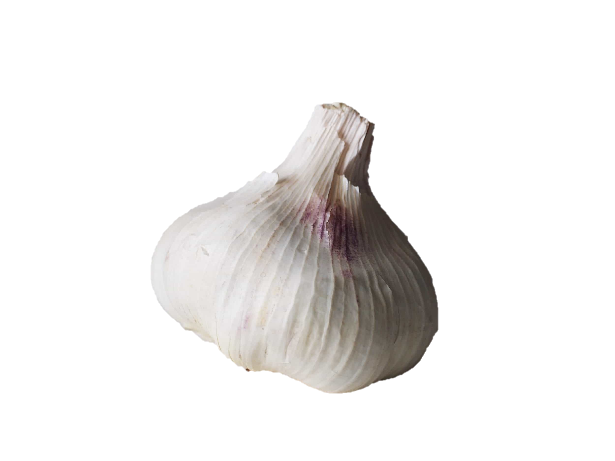
Frameworks On Offer

Slide 11
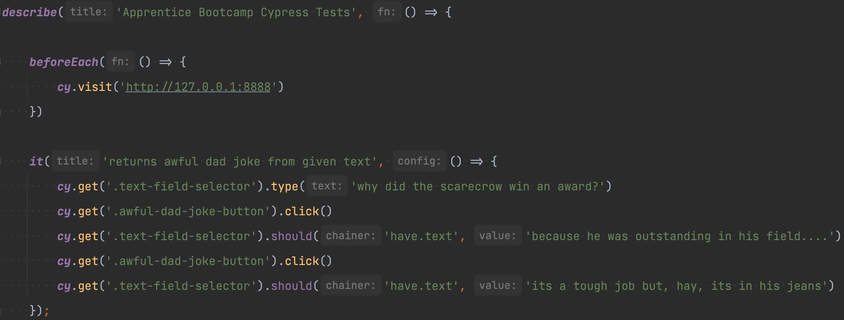
What do Cypress Tests look like?

Slide 12
What do Cypress Tests look like?

Slide 13
What do Cypress Tests look like?

Slide 14
What do Cypress Tests look like?

Slide 15
What do Cypress Tests look like?

Slide 16
What do Cypress Tests look like?

Slide 17
What do Cypress Tests look like?

Slide 18
What do Cypress Tests look like?

Slide 19
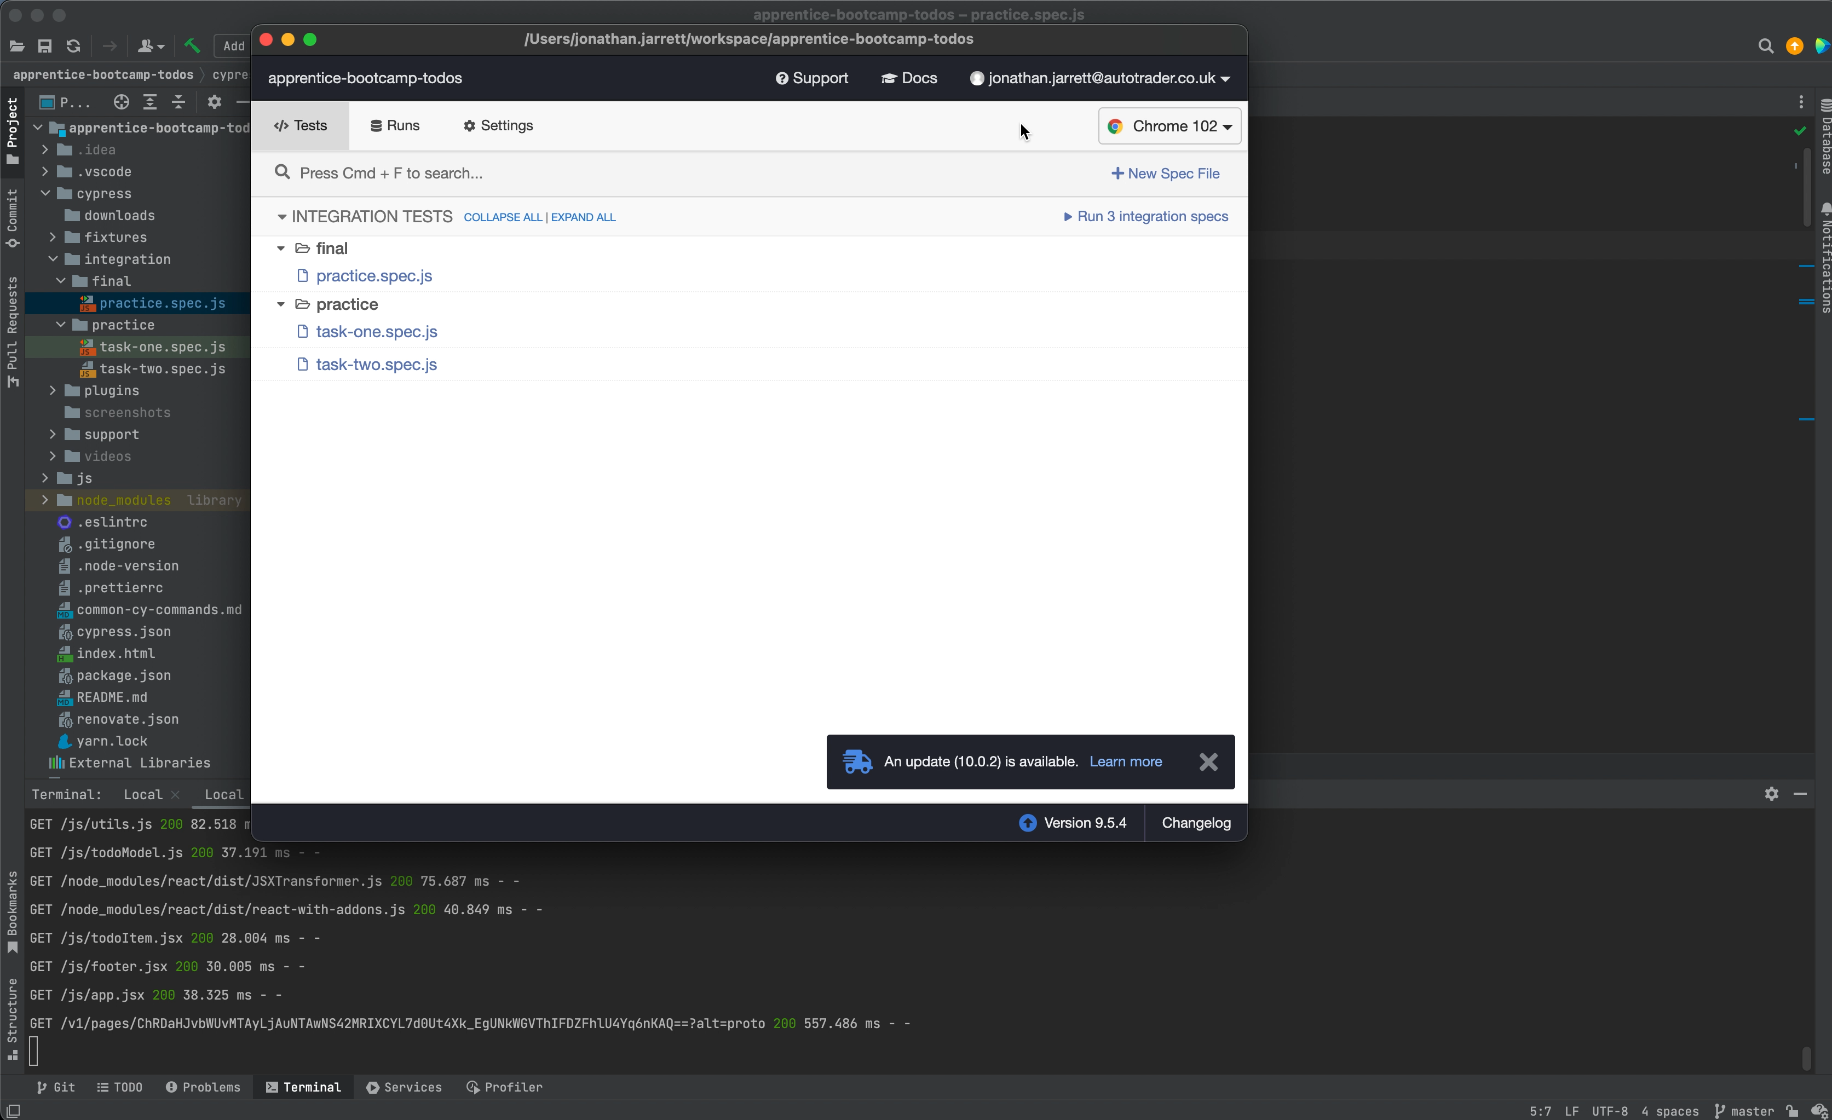
Frameworks On Offer

Slide 20
Frameworks On Offer
Your Task:
Step 1. Fork the repository sent in the Slack channel
Step 2: Open it in an IDE of your choice
Step 3: Read the README.md to get dependencies installed etc
Step 4: Complete the tests within task-one.spec.js in your pair.
Step 5: If you finish, have a go a writing your own test(s) that haven’t already been covered.
Time permitting, we’ll have a mini retro about Cypress tests at the end.

